Slide 1
Creating S.O.L.I.D Applications
The Single Responsibility Principle
Jay Smith
PMO Architect and Evangelist
Microsoft ASP .NET MVP

Slide 2
The Single Responsibility Principle
Every object in your system should have a single responsibility, and all the object’s services should be focused on carrying out a single responsibility.
Notes:
You’ve implemented the Single Responsibility Principle correctly when each of your objects only has one reason to change.

Slide 3
Don’t Repeat Yourself (DRY)
Avoid duplicate code by abstracting out things that are common and placing those things in a single location.
Notes:
SRP and DRY related and often appear together.
DRY is about putting a piece of functionality in a single place, such as a class.
SRP is about making sure that a class does only one thing, that that it does it well.
In good applications, one class does one thing, and does it well, and no other classes share the same behavior.

Slide 4
Testing for Single Responsibility
The OBJECT METHOD NAME itself.
The Automobile Start(s) itself.

Slide 5
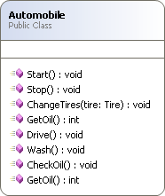
Example

Slide 6
Testing for Single Responsibility
The Automobile Start(s) itself.
The Automobile Stop(s) itself.
The Automobile ChangesTires(s) itself.
The Automobile Drive(s) itself.
The Automobile Wash(s) itself.
The Automobile Check(s) Oil itself.
The Automobile Get(s) Oil itself.

Slide 7
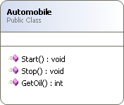
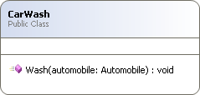
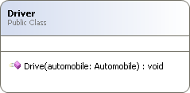
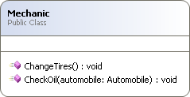
New Classes

